Slide 1
Pinelands music school
Website design
Release 1 review

Slide 2
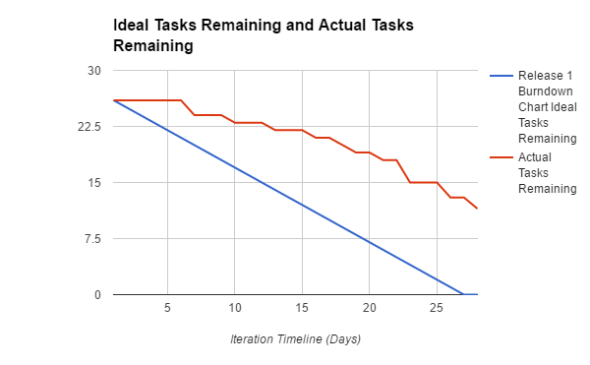
Release 1 Burndown

Slide 3
S34 - Responsive website layout
As a general user I want to be able to access the website on any device including mobile and tablets
Story points: 3 Completeness: 3

Slide 4
S20 - View submitted complaints
As a manager I want to be view any customer complaints that the school has received
Story points: 1 Completeness: 1

Slide 5
S4 - Reschedule Classes
As an existing student I want to be able to use the portal to reschedule my classes
Story points: 1 Completeness: 0

Slide 6
S6 - Search Avaiable Classes
As a new student I want to be able to search for the available services that the music school offers
Story points: 2 Completeness: 0

Slide 7
S10 - View Staff Roster
As a teacher View I want to be able to view my rosters for the upcoming classes
Story points: 1 Completeness: 0

Slide 8
S11 - View Class Schedules
As a teacher View I want to be able to view my the class schedule for the day
Story points: 1 Completeness: 0

Slide 9
S12 - View student enrolments
As a manager I want to be able to view the number of students enrolled in a class
Story points: 1 Completeness: 0

Slide 10
S14 - View students class
As a manager I want to be able to view the number of students enrolled in classes for a specified instrument (e.g. guitar)
Story points: 1 Completeness: 0

Slide 11
S21 - View Enrolment Statistics
As an Owner I want to be able to see how many students are enrolled in the music programs
Story points: 1 Completeness: 0

Slide 12
S23 - Monitor Music Interest
As an Owner I want to be able to view which areas of musical interest that our students are currently enrolled in at the school
Story points: 1 Completeness: 0

Slide 13
Story ID | Story Title | Story Points | Completion
S4 | Reschedule Classes | 1 | 0
S6 | Search Available Classes | 2 | 0
S10 | View Staff Roster | 1 | 0
S11 | View Class Schedules | 1 | 0
S12 | View Student Enrolments | 1 | 0
S14 | View Students by Class | 1 | 0
S20 | View Submitted Complaints | 1 | 1
S21 | View Enrolment Statistics | 1 | 0
S23 | Monitor Music Interest | 1 | 0
S34 | Responsive Website Layout | 3 | 3
2/10 Stories complete

